Slide 1

.
T
E-COMMERCE
SOFTWHERE
PRESENTATION
Represented By.
Saurabh Kumar Mishra &
Anshu Kumar Vishwakarma

Slide 2
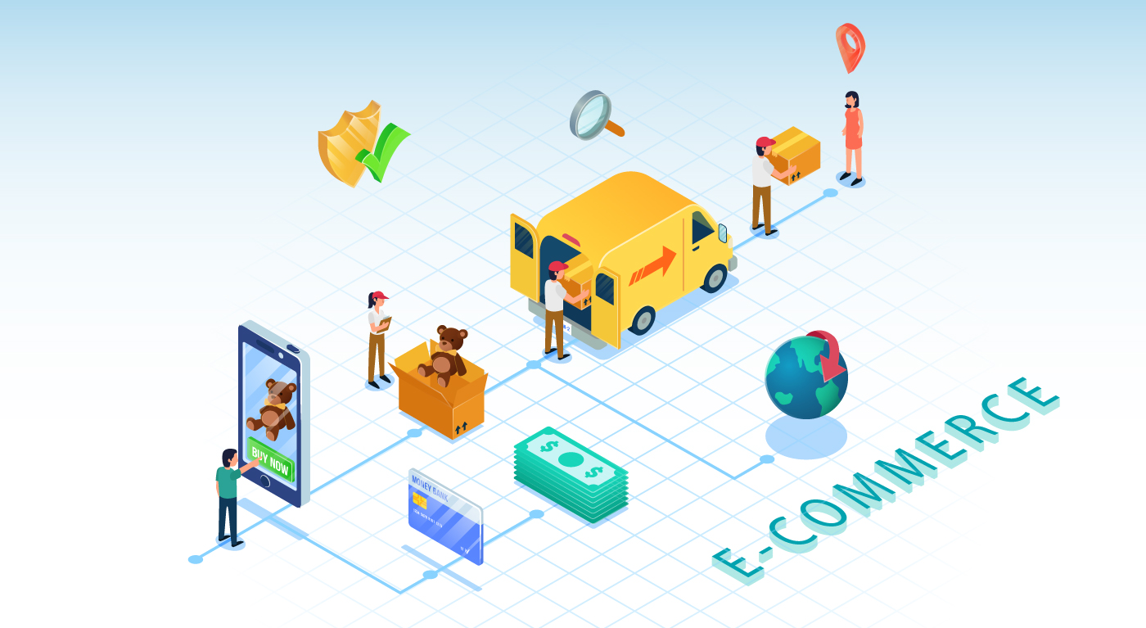




Table Of Contents
Introduction
Analysis
Overview of E-Commerce website
Used Language
E-R Diagram
Working
Conclusion
Demo of the Project
Future Work
Referance

Slide 3

01
Introduction

Slide 4

ABOUT OUR SOFTWARE
Online Shopping is a form of electronic commerce whereby consumers directly buy goods or services from a seller over the Internet without any intermediary service.
Our Company

Slide 5
02
Analysis

Slide 6







Language are Used --
HTML 5
BOOTSTRAP
PYTHON
SQ LITE
DJANGO

Slide 7
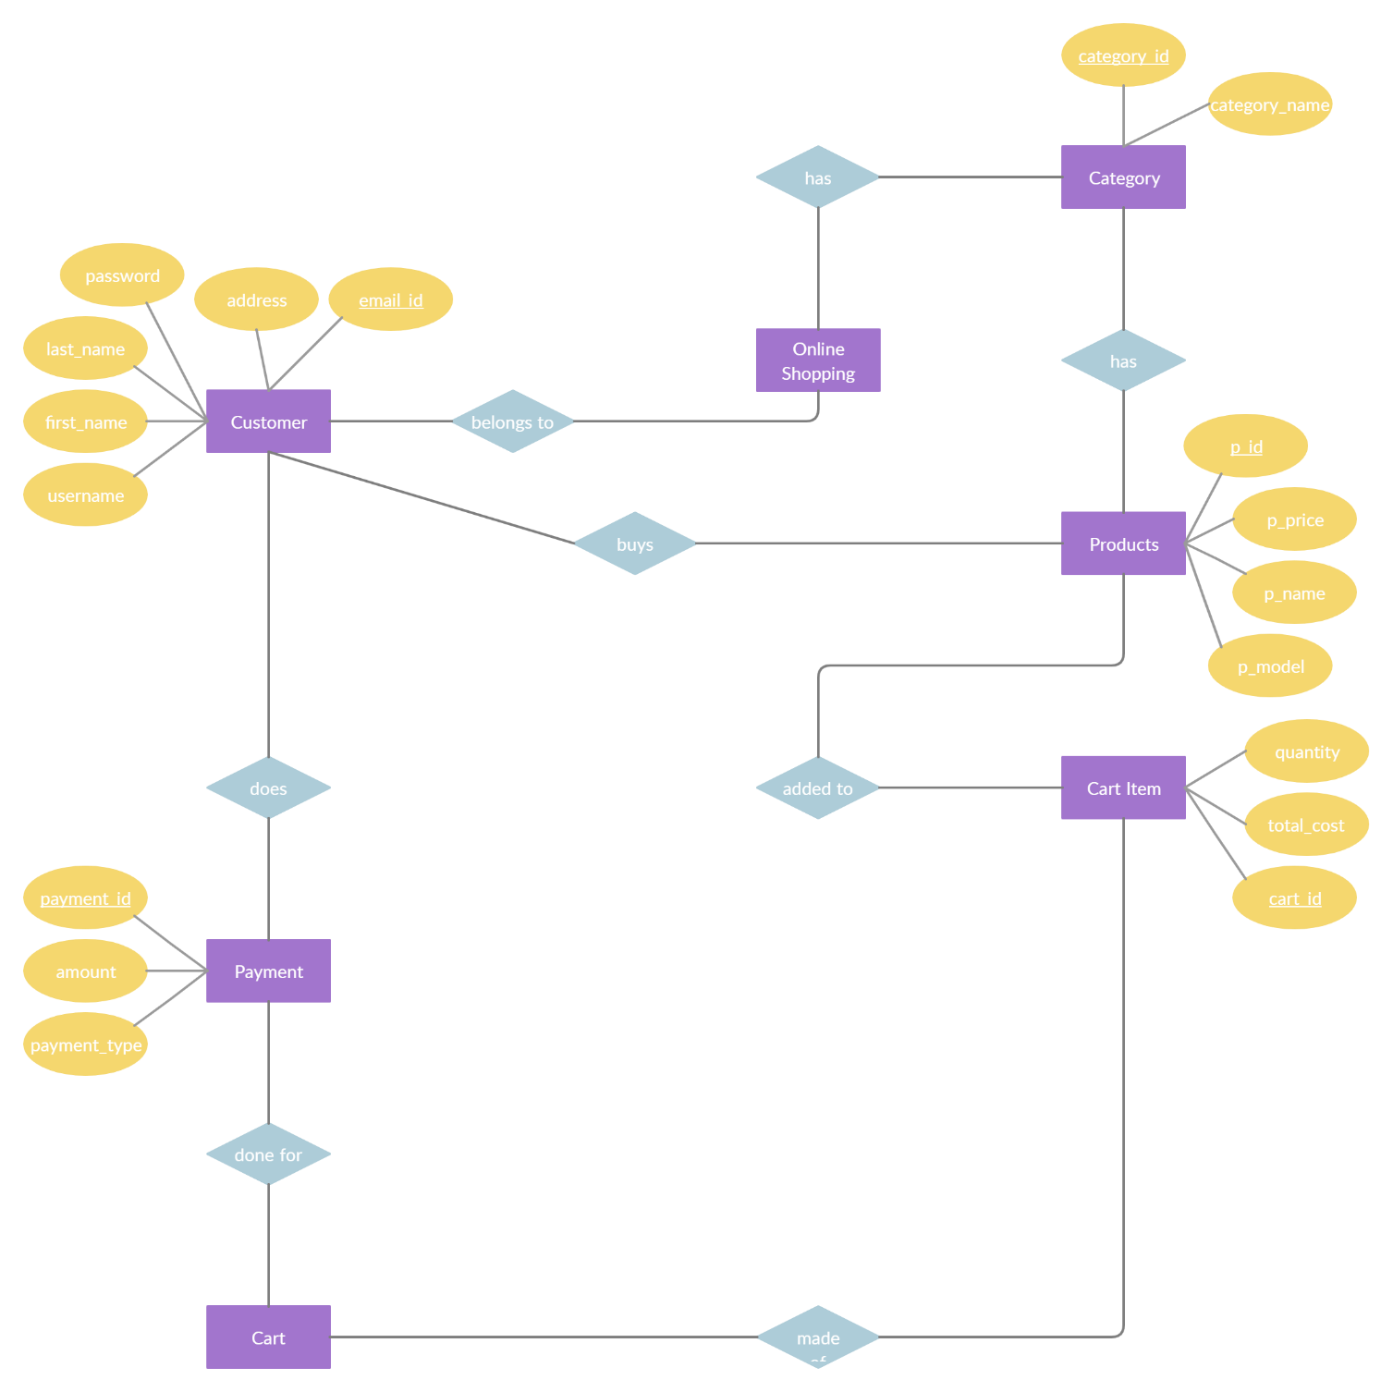
E-R DIAGRAM --

Slide 8
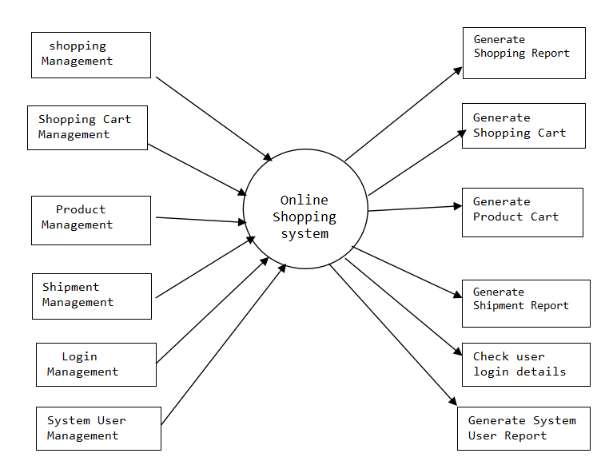
DATA FLOW DIAGRAM --
0 LEVEL DFD
1 LEVEL DFD
Request for Login
Online Shopping
Request for Registration
ADMIN
USER
Response
Response

Slide 9
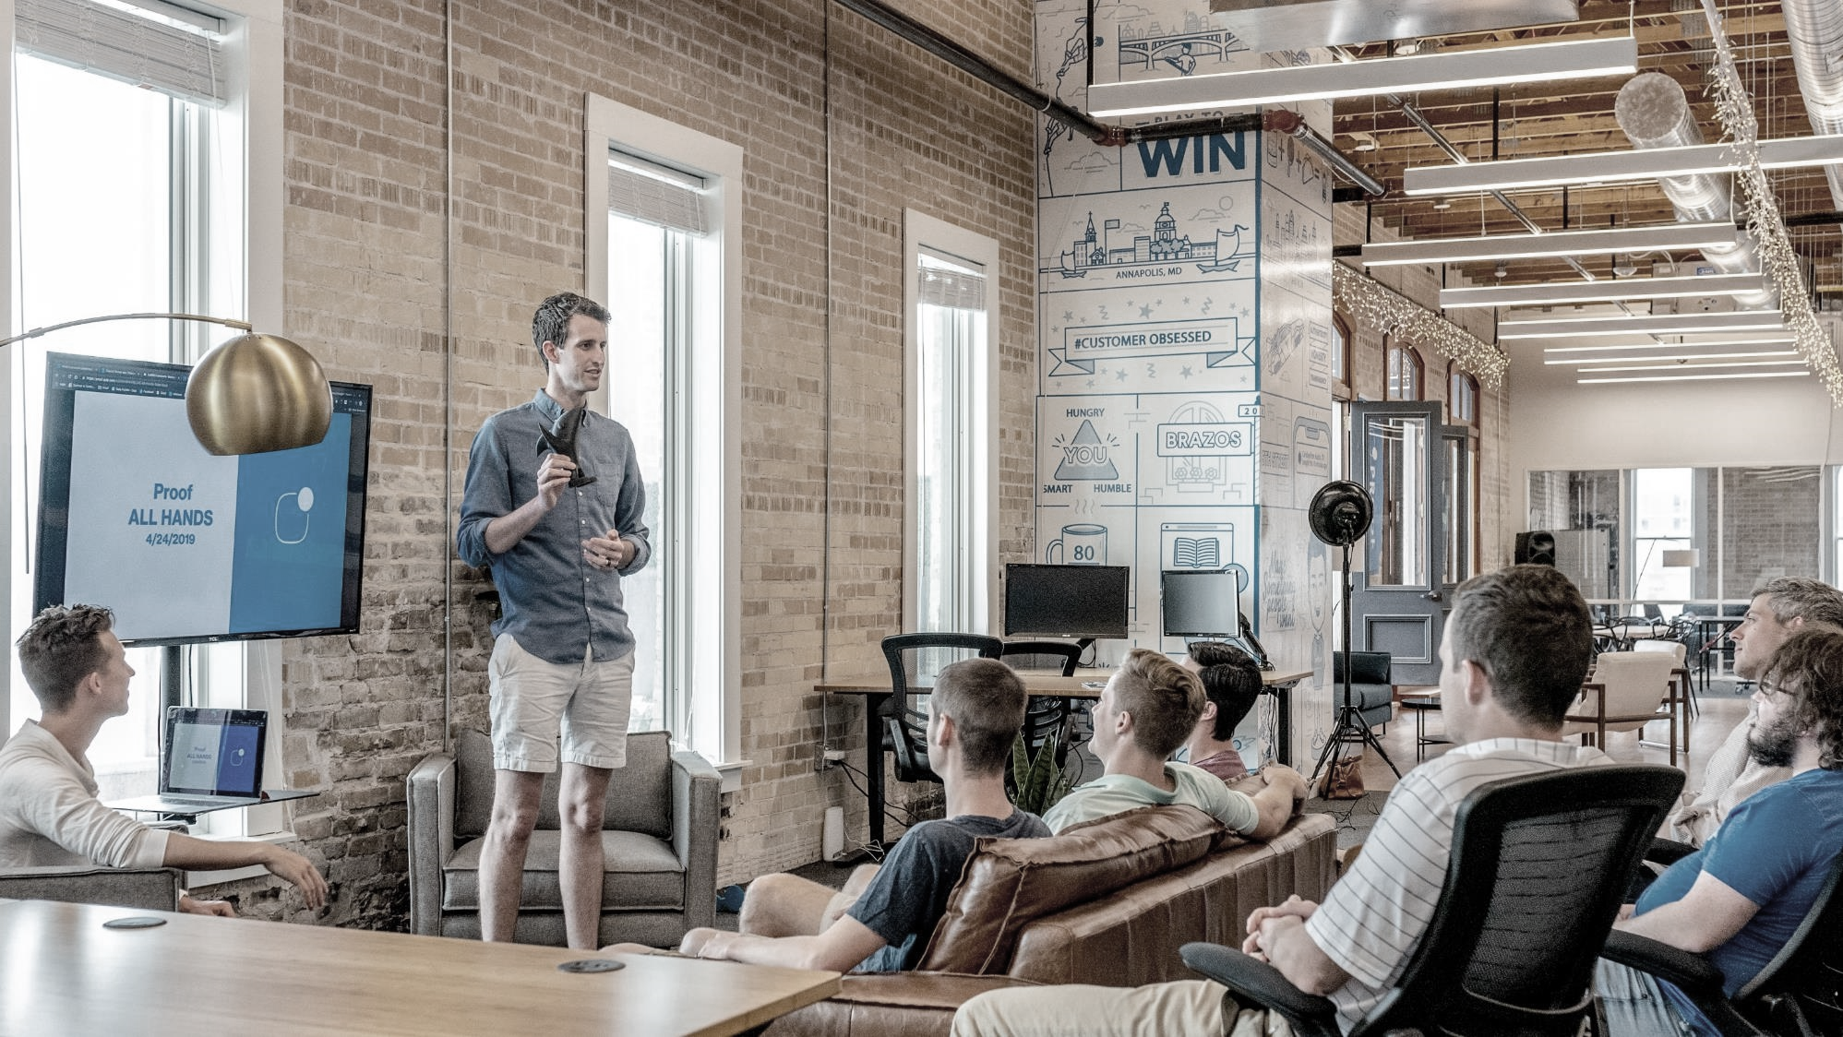
03
WORKING

Slide 10
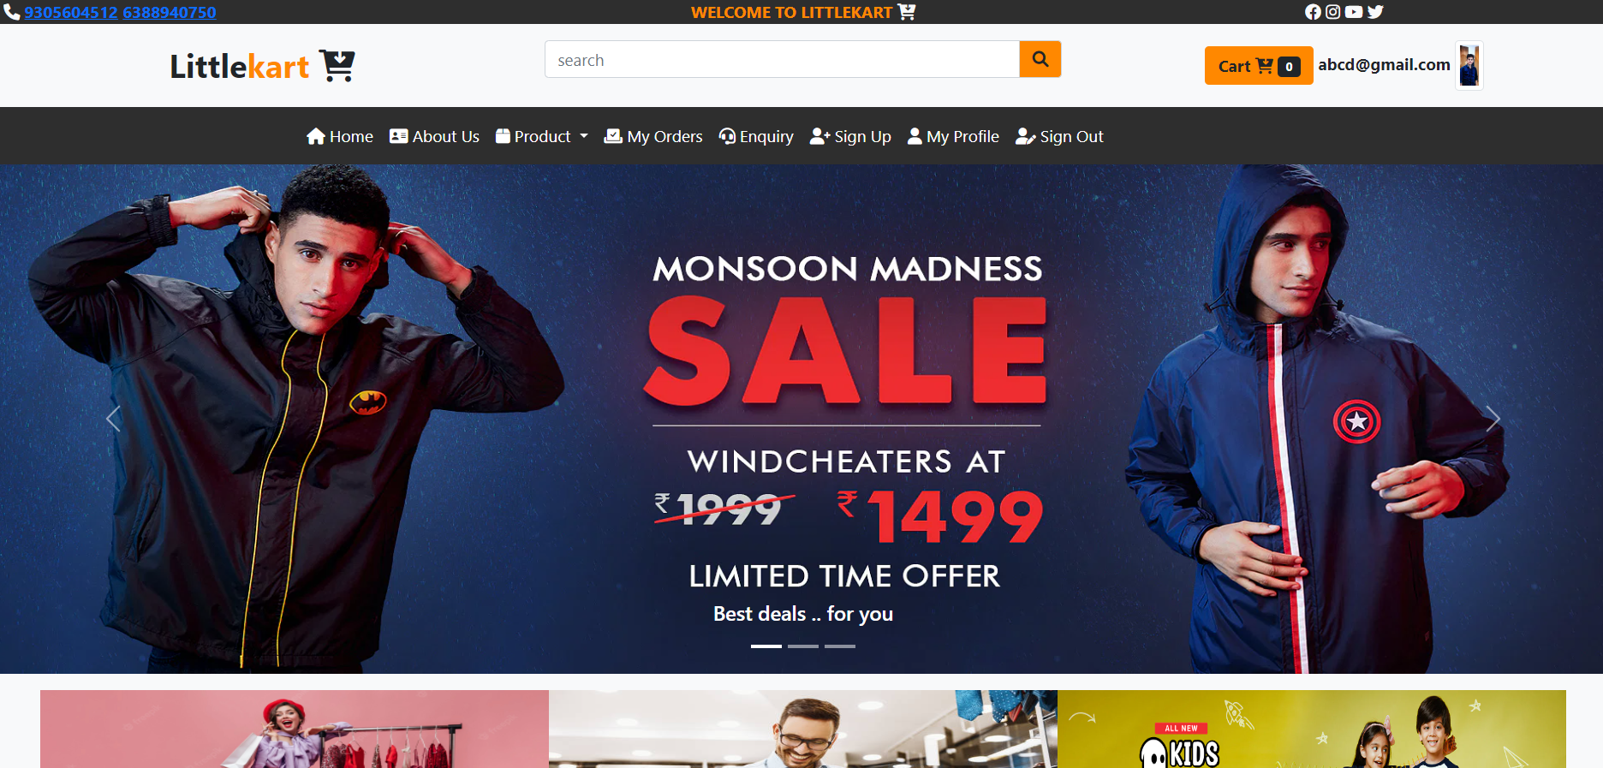
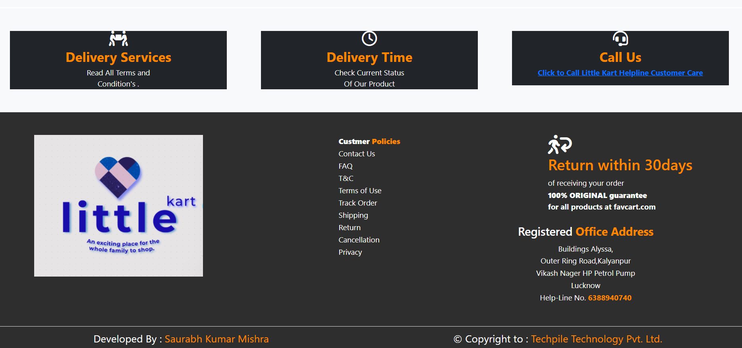

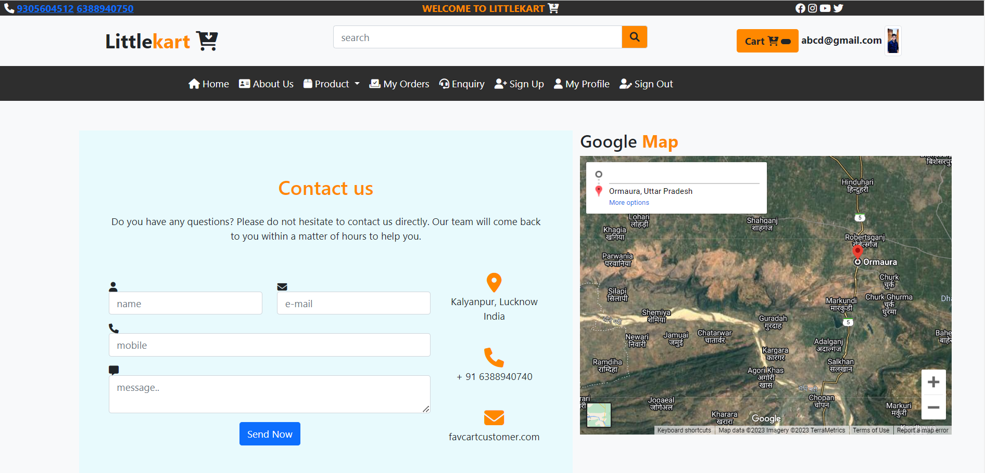
DEMO [ SNAPSHOT OF THE PROJECT ] --

Slide 11
04
CONCLUSION

Slide 12
“ E-Commerce is an Evolution ”
- By using electronic technology through the internet, it achieved :
More competition, more marketplaces, faster transactions, and more advanced technologies to make activities between customers and producers more active.
We as customers and internet users are responsible to keep our e-commerce healthy and safe so that e-business can be more reliable in future.

Slide 13

05
FUTURE WORK

Slide 14
SCOPE OF FUTURE --
New marketing channels will emerge.
Adding voice search option.
increasing the security
Enhance their UI.

Slide 15
06
REQUIREMENT
To build a softwere

Slide 16
SERVER-SIDE HARDWARE REQUIREMENT: Intel core i5
32GB Ram 256 GB SSD Network Interface card IIS CD-Drive
SERVER-SIDE SOFTWARE REQUIREMENT:
Windows
Python 3.7 and PyCharm IDE 2021.3
SQLite [ Database]

Slide 17
07
REFERENCE

Slide 18
Reference Sources of E-Commerce --
Books
Internet Sites
Video Clips
YouTube
Other E-Commerce Sites & Application.
Senior Members

Slide 19
Thank you
Saurabh Kumar Mishra &
Anshu Kumar Vishwakarma

